Slide 1

Light up the World by LED

Slide 2
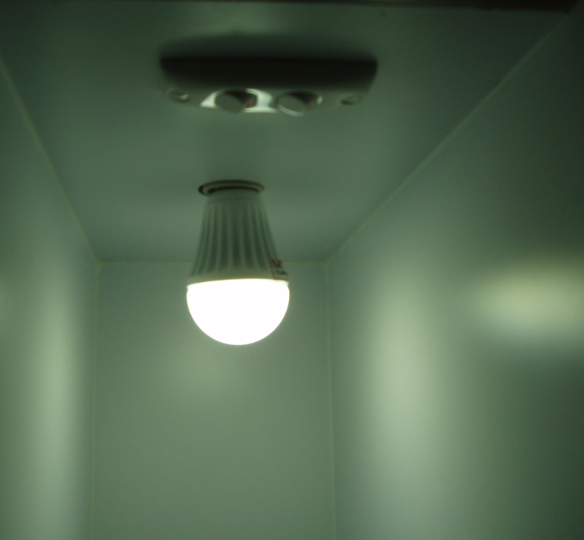
E27 High efficient LED Bulb

Slide 3
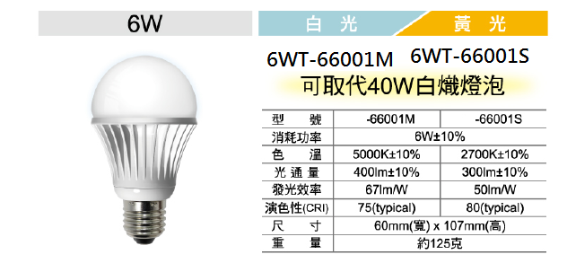
6W LED Bulb
Use American Cree chip

Slide 4
Features
*Outdoor and Indoor usage
*10000 hours life usage
*LED Light source can last 40000 hours
*Cree LED chip ( International Factory )
*Speciality Technology
*Aluminum alloy Base for cooling
*Plastics cover for fall down

Slide 5
Features
*Quickly Light up (no delay & no twinkle)
*Accommodating now E27 Base to fixed up
*No Chemistry mercury (Hg) for human safty
*No Ultraviolet (UV) rays ,No Infrared rays;
*Easy to protect the Culture Picture and Paint

Slide 6
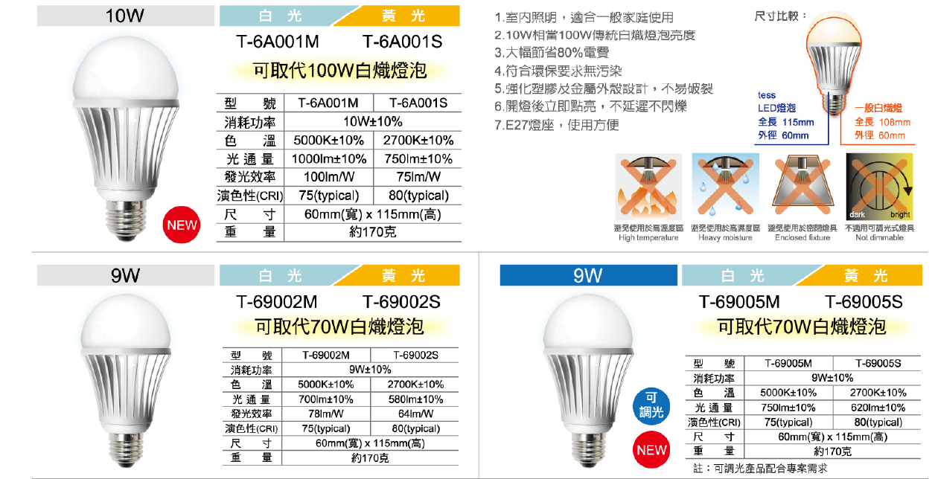
New Product 10W LED Bulb

Slide 7
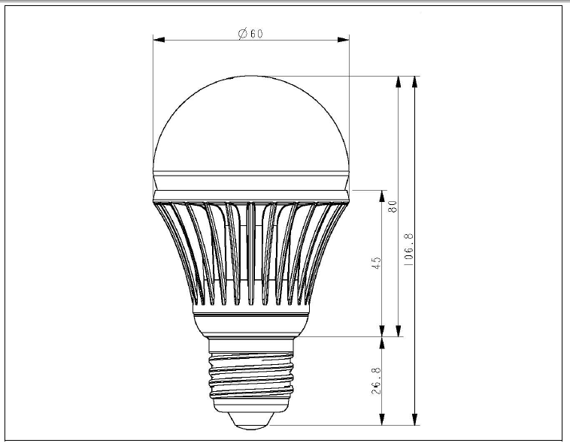
Outline

Slide 8
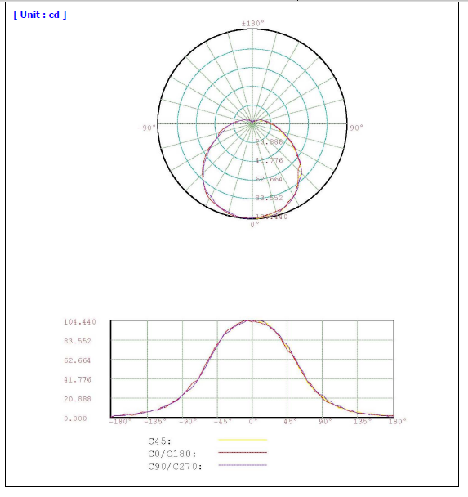
LIGHT DISTRIBUTION CURVES

Slide 9
Laboratory Test
Laboratory Test condition:
Hih temperature 60°C ( 3000 Hours )
Start / Shut down power test under temperature @50°C ( 8000次)。
Start / Shut down power test under temperature @-5°C ( 16 hours)。
Cycle temperature @60°C and@-5°C
(72 hours)。

